Slide 1
Lecture 13 JavaFX Basics
Download the code files from the Canvas homepage.

Slide 2
Motivations
JavaFX is a new framework for developing Java Graphical User Interface (GUI) programs.
The JavaFX API is an excellent example of how the object- oriented principle is applied. This chapter serves two purposes.
First, it presents the basics of JavaFX programming. Second, it uses JavaFX to demonstrate object-oriented design and programming.
Specifically, this chapter introduces the framework of JavaFX and discusses JavaFX GUI components and their relationships.

Slide 3
JavaFX vs Swing and AWT
Swing and AWT are replaced by the JavaFX platform for developing rich Internet applications.
When Java was introduced, the GUI classes were bundled in a library known as the Abstract Windows Toolkit (AWT).
AWT is fine for developing simple graphical user interfaces, but not for developing comprehensive GUI projects.
In addition, AWT is prone to platform-specific bugs.
The AWT user-interface components were replaced by a more robust, versatile, and flexible library known as Swing components.
Swing components are painted directly on canvases using Java code.
Swing components depend less on the target platform and use less of the native GUI resource.
With the release of Java 8, Swing is replaced by a completely new GUI platform known as JavaFX.

Slide 4
Basic Structure of JavaFX
javafx.application.Application
Override the start(Stage) method
Stage, Scene, and Nodes
Stage Scene
Button
MyJavaFX
MultipleStageDemo

Slide 5
MyJavaFX
public class MyJavaFX extends Application { @Override
public void start(Stage primaryStage) {
// Create a button and place it in the scene Button btOK = new Button("OK");
Scene scene = new Scene(btOK, 200, 250); primaryStage.setTitle("MyJavaFX"); // Set the stage title
primaryStage.setScene(scene); // Place the scene in the stage primaryStage.show(); // Display the stage
}
public static void main(String[] args) {
launch(args);
}
}

Slide 6
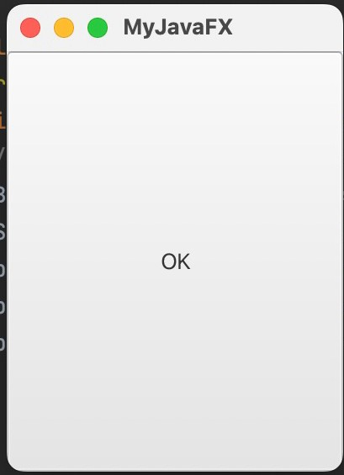
MyJavaFX
MyJavaFX

Slide 7
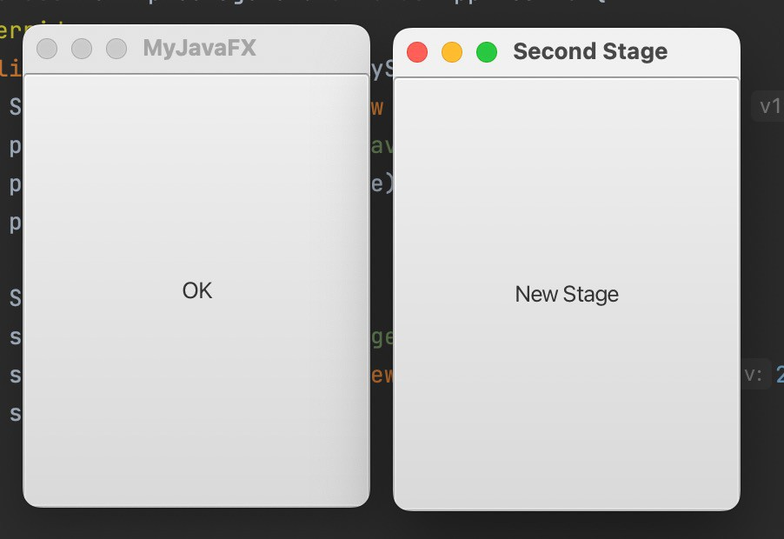
MultipleStageDemo

Slide 8
MultipleStageDemo
public class MultipleStageDemo extends Application{ @Override
public void start(Stage primaryStage){
Scene scene = new Scene(new Button( ), 200, 250);
primaryStage.setTitle( primaryStage.setScene(scene); primaryStage.show();
);
Stage stage = new Stage(); stage.setTitle( stage.setScene(new stage.show();
);
(new
(
),200, 250));

Slide 9
MultipleStageDemo
public class MultipleStageDemo extends Application{ @Override
public void start(Stage primaryStage){
Scene scene = new Scene(new Button("OK"), 200, 250);
primaryStage.setTitle("MyJavaFX");
primaryStage.setScene(scene); primaryStage.show();
Stage stage = new Stage();
stage.setTitle("Second Stage");
stage.setScene(new Scene(new Button("New Stage"),200, 250));
stage.show();
}
}

Slide 10
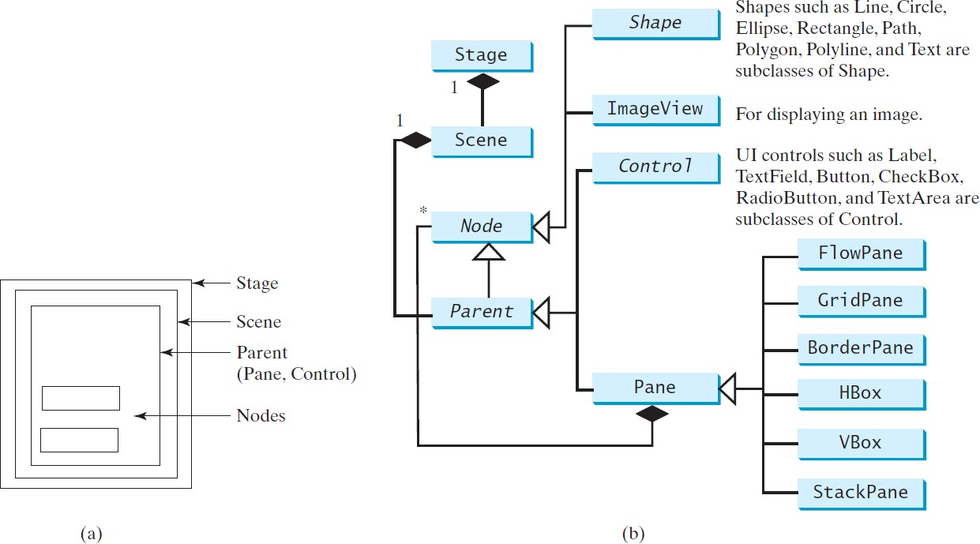
Panes, UI Controls, and Shapes
ButtonInPane

Slide 11
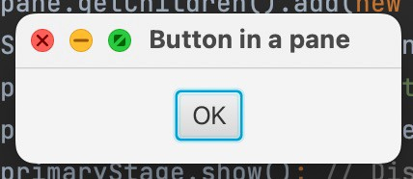
ButtonInPane
public void start(Stage primaryStage) {
// Create a scene and place a button in the scene StackPane pane = new StackPane(); pane.getChildren().add(new ( )); Scene scene = new Scene( , 200, 50);
primaryStage. ( ); // Set the stage title
.setScene( ); // Place the scene in the stage
.show(); // Display the stage

Slide 12
ButtonInPane
public void start(Stage primaryStage) {
// Create a scene and place a button in the scene StackPane pane = new StackPane();
pane.getChildren().add(new Button("OK"));
Scene scene = new Scene(pane, 200, 50);
primaryStage.setTitle("Button in a pane");
// Set the stage title
primaryStage.setScene(scene);
// Place the scene in the stage
primaryStage.show(); // Display the stage

Slide 13
Display a Shape
This example displays a circle in the center of the pane.
(0, 0)
X Axis
Y Axis
y
(x, y)
(0, 0)
X Axis
Java Coordinate System
Conventional Coordinate System
Y Axis
ShowCircle

Slide 14
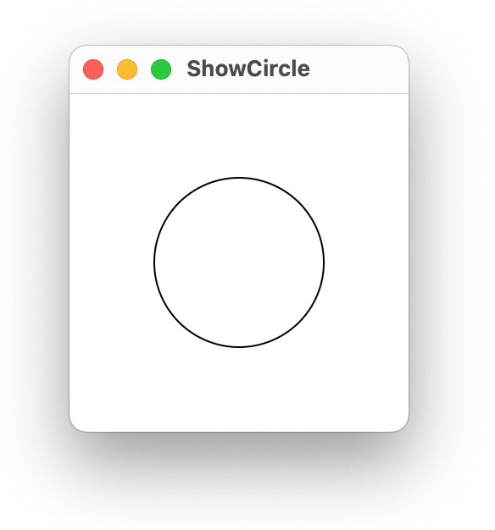
ShowCircle
public void start(Stage primaryStage) {
// Create a circle and set its properties Circle circle = new Circle(); circle.setCenterX(100); circle.setCenterY(100); circle.setRadius(50); circle.setStroke(Color.BLACK);
circle.setFill(null);
// Create a pane to hold the circle
// Create a scene and place it in the stage

Slide 15
ShowCircle
public void start(Stage primaryStage) {
// Create a circle and set its properties
// Create a pane to hold the circle Pane pane = new Pane();
pane. ().add( );
// Create a scene and place it in the stage scene = new Scene( , 200, 200);
primaryStage.setTitle( ); // Set the stage title
primaryStage.setScene( ); // Place the scene in the stage primaryStage.show(); // Display the stage

Slide 16
ShowCircle
public void start(Stage primaryStage) {
// Create a circle and set its properties
// Create a pane to hold the circle Pane pane = new Pane();
pane.getChildren().add(circle);
// Create a scene and place it in the stage
Scene scene = new Scene(pane, 200, 200);
primaryStage.setTitle("ShowCircle");
// Set the stage title
primaryStage.setScene(scene);
// Place the scene in the stage
primaryStage.show(); // Display the stage
}

Slide 17
Binding Properties
JavaFX introduces a new concept called binding property that enables a target object to be bound to a source object.
If the value in the source object changes, the target property is also changed automatically.
The target object is simply called a binding object or a
binding property.
A target “listens” to the changes in the source and automatically updates itself once a change is made in the source.
A target binds with a source using the bind method as follows:
target.bind(source);

Slide 18
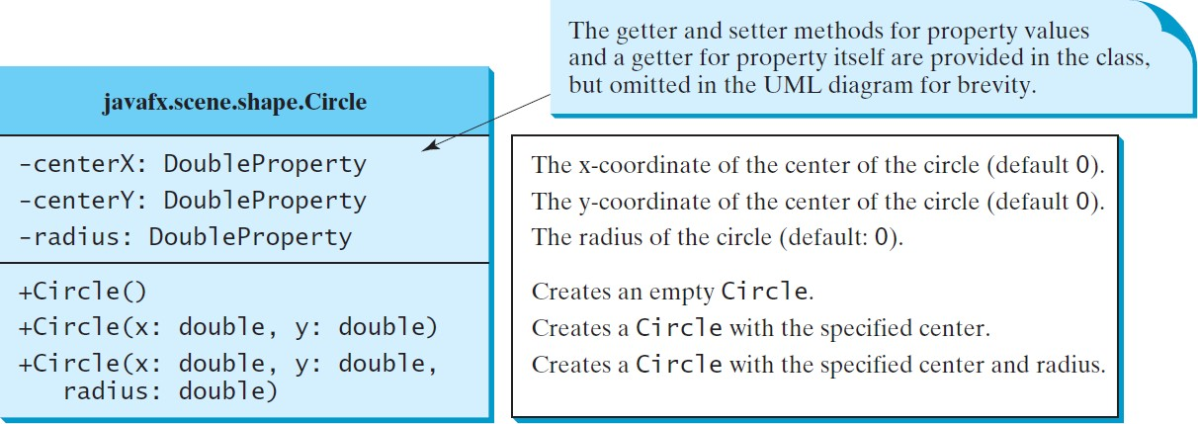
Circle

Slide 19
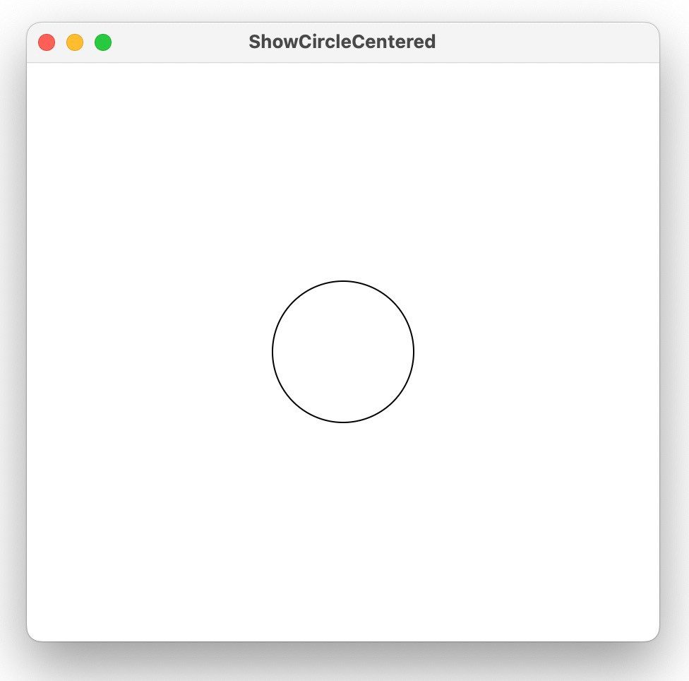
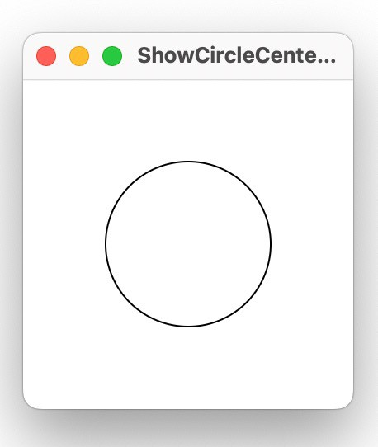
ShowCircleCentered

Slide 20
ShowCircleCentered
@Override // Override the start method in the Application class public void start(Stage primaryStage) {
// Create a pane to hold the circle Pane pane = new Pane();
// Create a circle and set its properties Circle circle = new Circle();
circle.centerXProperty().bind(pane.widthProperty().divide(2));
circle.centerYProperty().bind(pane.heightProperty().divide(2));
circle.setRadius(50); circle.setStroke(Color.BLACK); circle.setFill(Color.WHITE);
pane.getChildren().add(circle); // Add circle to the pane
// Create a scene and place it in the stage Scene scene = new Scene(pane, 200, 200);
primaryStage.setTitle("ShowCircleCentered"); // Set the stage title
primaryStage.setScene(scene); // Place the scene in the stage primaryStage.show(); // Display the stage
}
20

Slide 21
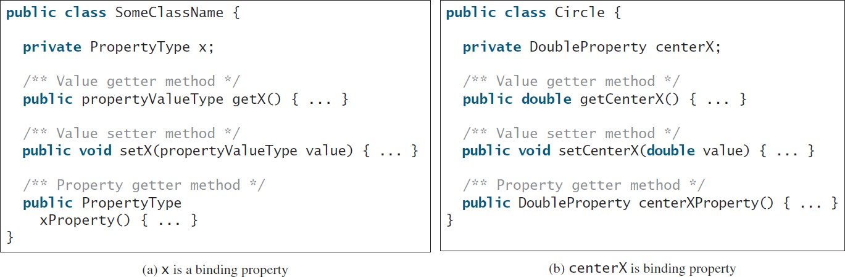
Binding Property:
getter, setter, and property getter
21

Slide 22
Uni/Bidirectional Binding
import javafx.beans.property.DoubleProperty; import javafx.beans.property.SimpleDoubleProperty;
public class BindingDemo {
public static void main(String[] args) {
DoubleProperty d1 = new SimpleDoubleProperty(1); DoubleProperty d2 = new SimpleDoubleProperty(2);
d1.bind(d2);
System.out.println("d1 is " + d1.getValue()
+ " and d2 is " + d2.getValue()); d2.setValue(70.2);
System.out.println("d1 is " + d1.getValue()
+ " and d2 is " + d2.getValue());
}
}
22

Slide 23
Uni/Bidirectional Binding
import javafx.beans.property.DoubleProperty; import javafx.beans.property.SimpleDoubleProperty;
public class BindingDemo {
public static void main(String[] args) {
DoubleProperty d1 = new SimpleDoubleProperty(1); DoubleProperty d2 = new SimpleDoubleProperty(2);
d1.bind(d2);
System.out.println("d1 is " + d1.getValue()
+ " and d2 is " + d2.getValue());
d2.setValue(70.2);
System.out.println("d1 is " + d1.getValue()
+ " and d2 is " + d2.getValue());
}
}
23

Slide 24
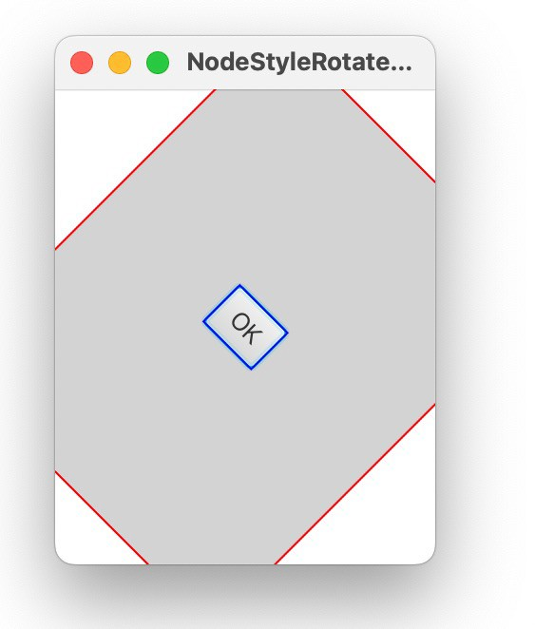
Common Properties and Methods for Nodes
style: set a JavaFX CSS style
circle.setStyle("−fx−stroke: black; −fx−fill: red;");
circle.setStroke(Color.BLACK); circle.setFill(Color.RED);
rotate: Rotate a node
button.setRotate(80);

Slide 25

NodeStyleRotateDemo
public void start(Stage primaryStage) {
// Create a scene and place a button in the scene StackPane pane = new StackPane();
Button btOK = new Button("OK");
.setStyle("-fx-border-color: "); pane.getChildren().add( );
pane. (45); pane.setStyle(
);
Scene scene = new Scene(pane, 200, 250); primaryStage.setTitle("NodeStyleRotateDemo"); // Set the stage title primaryStage.setScene(scene); // Place the scene in the stage primaryStage.show(); // Display the stage
}

Slide 26
NodeStyleRotateDemo
public void start(Stage primaryStage) {
// Create a scene and place a button in the scene StackPane pane = new StackPane();
Button btOK = new Button("OK");
btOK.setStyle("-fx-border-color: blue;");
pane.getChildren().add(btOK);
pane.setRotate(45);
pane.setStyle("-fx-border-color: red; -fx-background-color: lightgray;");
Scene scene = new Scene(pane, 200, 250); primaryStage.setTitle("NodeStyleRotateDemo"); // Set the stage title primaryStage.setScene(scene); // Place the scene in the stage primaryStage.show(); // Display the stage
}

Slide 27
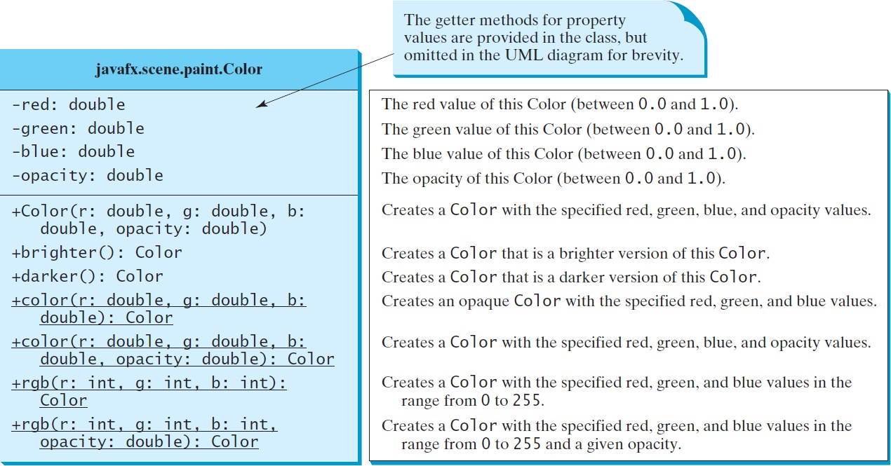
The Color Class

Slide 28
The Color Class
public Color(double r, double g, double b, double opacity);
Color color = new Color(0.25, 0.14, 0.333, 0.51);

Slide 29
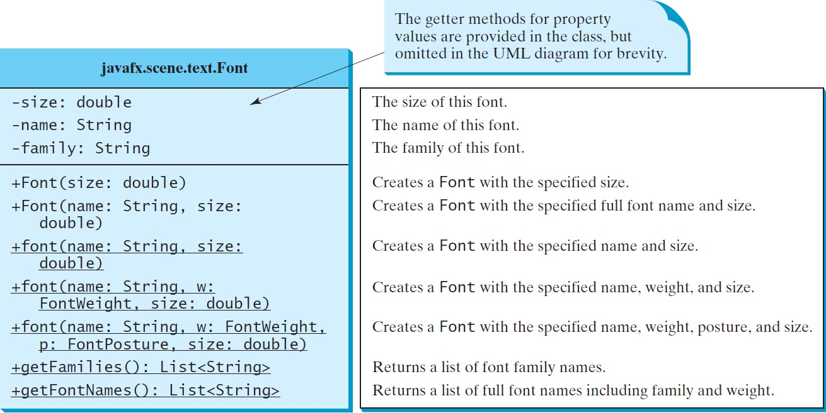
The Font Class
FontDemo

Slide 30
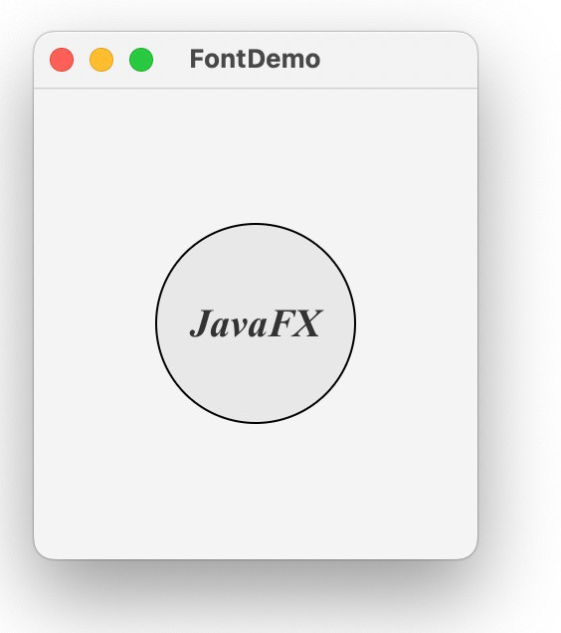
FontDemo

Slide 31
FontDemo
public void start(Stage primaryStage) {
// Create a pane to hold the circle Pane pane = new StackPane();
// Create a circle and set its properties Circle circle = new Circle(); circle.setRadius(50); circle.setStroke(Color.BLACK); circle.setFill(new Color(0.5, 0.5, 0.5, 0.1));
pane.getChildren().add(circle); // Add circle to the pane
// Create a label and set its properties Label label = new Label( ); label.setFont( (
FontWeight. , FontPosture. pane.getChildren().add(label);
,
, 20));
// Create a scene and place it in the stage
}

Slide 32
FontDemo
public void start(Stage primaryStage) {
// Create a pane to hold the circle
Pane pane = new StackPane();
// Create a circle and set its properties
Circle circle = new Circle();
circle.setRadius(50); circle.setStroke(Color.BLACK); circle.setFill(new Color(0.5, 0.5, 0.5, 0.1));
pane.getChildren().add(circle); // Add circle to the pane
// Create a label and set its properties
Label label = new Label("JavaFX");
label.setFont(Font.font("Times New Roman",
FontWeight.BOLD, FontPosture.ITALIC, 20));
pane.getChildren().add(label);
// Create a scene and place it in the stage
}

Slide 33
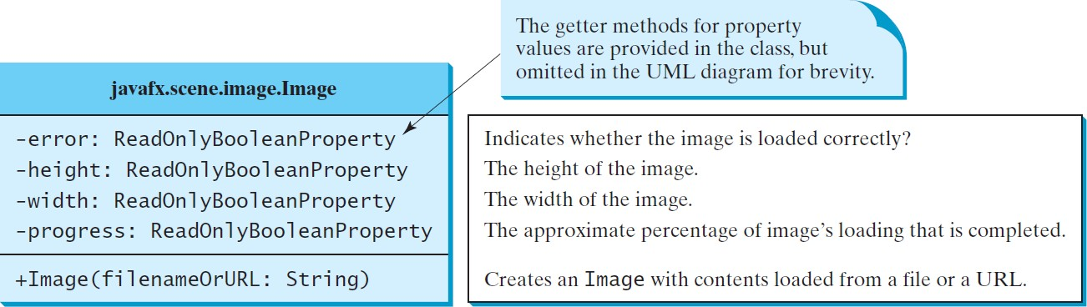
The Image Class

Slide 34
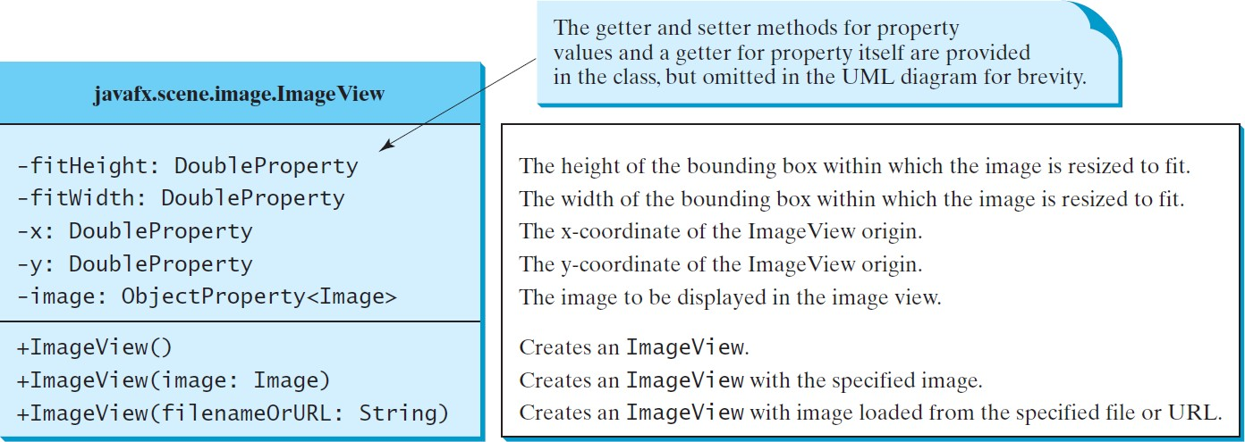
The ImageView Class
ShowImage

Slide 35
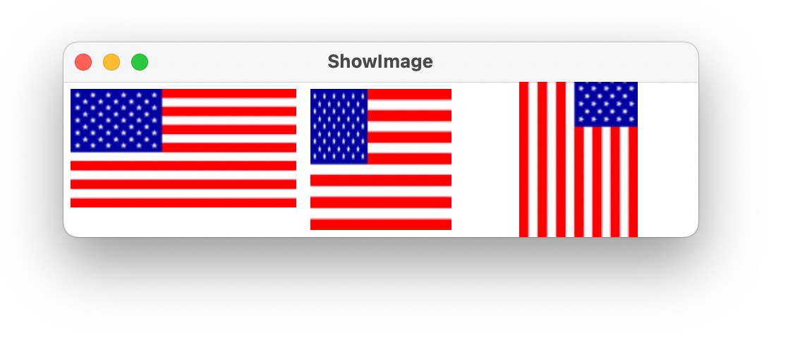
ShowImage

Slide 36
ShowImage
public void start(Stage primaryStage) {
// Create a pane to hold the image views Pane pane = new HBox(10); pane.setPadding(new Insets(5, 5, 5, 5));
Image image = new ("http://liveexample.pearsoncmg.com/book/image/us.gif"); pane.getChildren().add(new (image));
ImageView imageView2 = new (image); imageView2.setFitHeight(100); imageView2.setFitWidth( );
pane.getChildren(). (imageView2);
ImageView imageView3 = new (image); imageView3.setRotate( );
pane.getChildren(). (imageView3);

Slide 37
ShowImage
public void start(Stage primaryStage) {
// Create a pane to hold the image views Pane pane = new HBox(10); pane.setPadding(new Insets(5, 5, 5, 5));
Image image = new Image("http://liveexample.pearsoncmg.com/book/image/us.gif");
pane.getChildren().add(new ImageView(image));
ImageView imageView2 = new ImageView(image);
imageView2.setFitHeight(100);
imageView2.setFitWidth(100);
pane.getChildren().add(imageView2);
ImageView imageView3 = new ImageView(image);
imageView3.setRotate(90);
pane.getChildren().add(imageView3);

Slide 38
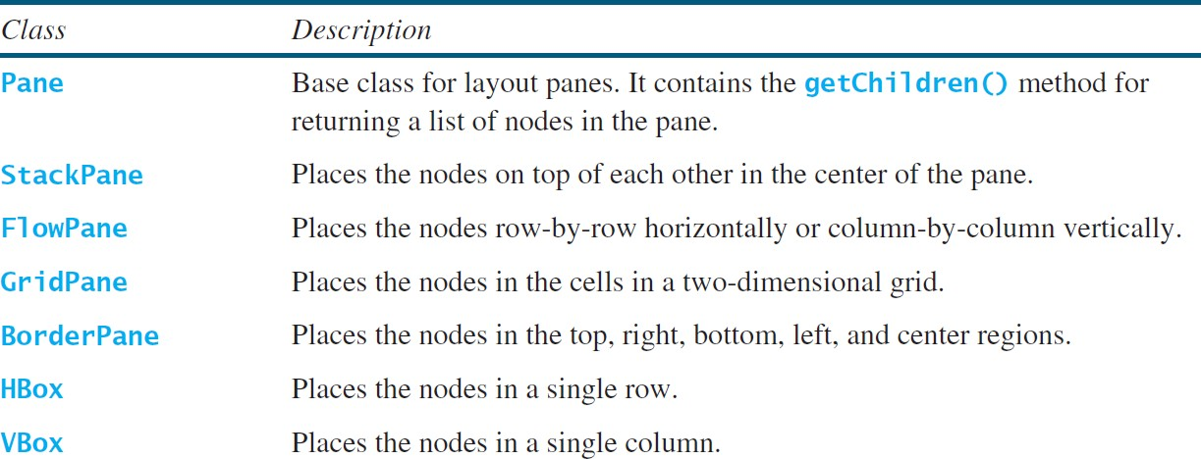
Layout Panes
JavaFX provides many types of panes for organizing nodes in a container.

Slide 39
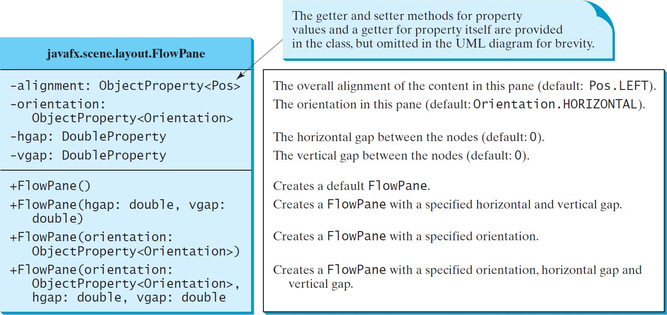
FlowPane
MultipleStageDemo

Slide 40
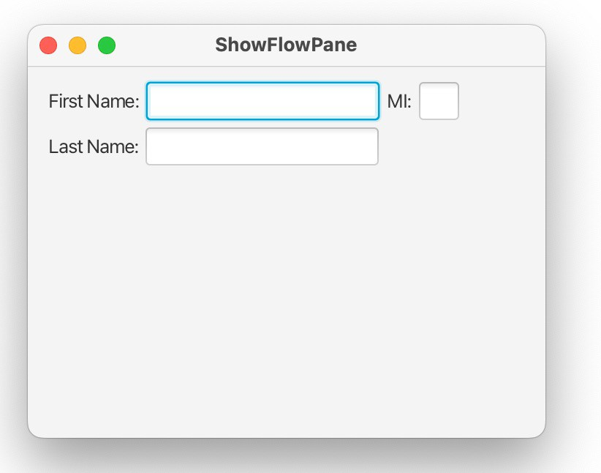
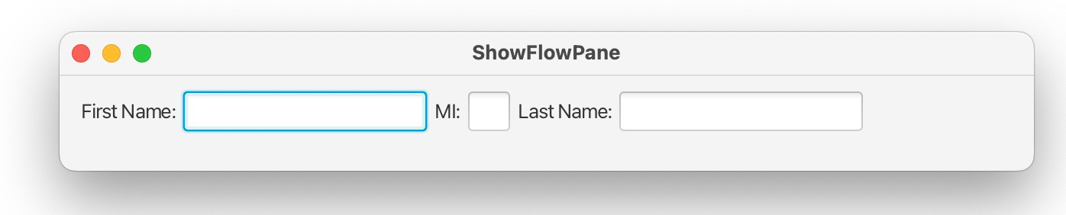
ShowFlowPane

Slide 41
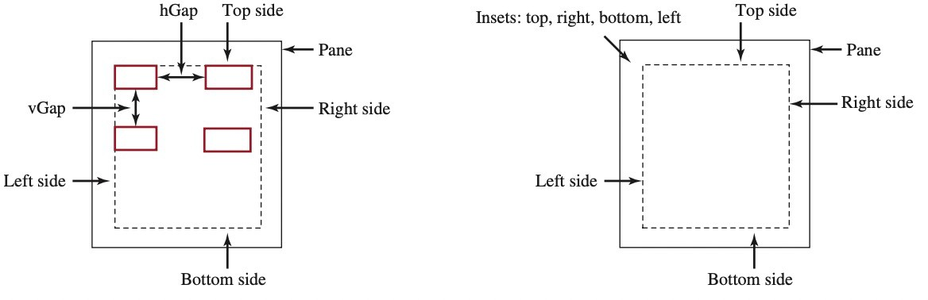
ShowFlowPane
The program creates a FlowPane and sets its padding property with an Insets object.
An Insets object specifies the size of the border of a pane.
For example, the constructor Insets(11, 12, 13, 14) creates an Insets with the border sizes for top (11), right (12), bottom (13), and left (14) in pixels

Slide 42
ShowFlowPane
public void start(Stage primaryStage) {
// Create a pane and set its properties FlowPane pane = new ;
pane.setPadding(new Insets(11, 12, 13, 14)); pane.setHgap(5);
pane.setVgap(5);
// Place nodes in the pane
pane.getChildren(). (new Label("First Name:"), new TextField(), new Label("MI:"));
TextField tfMi = new TextField(); tfMi.setPrefColumnCount(1); pane.getChildren().addAll(tfMi, new Label("Last Name:"),
new TextField());
// Create a scene and place it in the stage

Slide 43
ShowFlowPane
public void start(Stage primaryStage) {
// Create a pane and set its properties
FlowPane pane = new FlowPane();
pane.setPadding(new Insets(11, 12, 13, 14));
pane.setHgap(5); pane.setVgap(5);
// Place nodes in the pane
pane.getChildren().addAll(new Label("First Name:"),
new TextField(), new Label("MI:"));
TextField tfMi = new TextField(); tfMi.setPrefColumnCount(1); pane.getChildren().addAll(tfMi, new Label("Last Name:"),
new TextField());
// Create a scene and place it in the stage

Slide 44
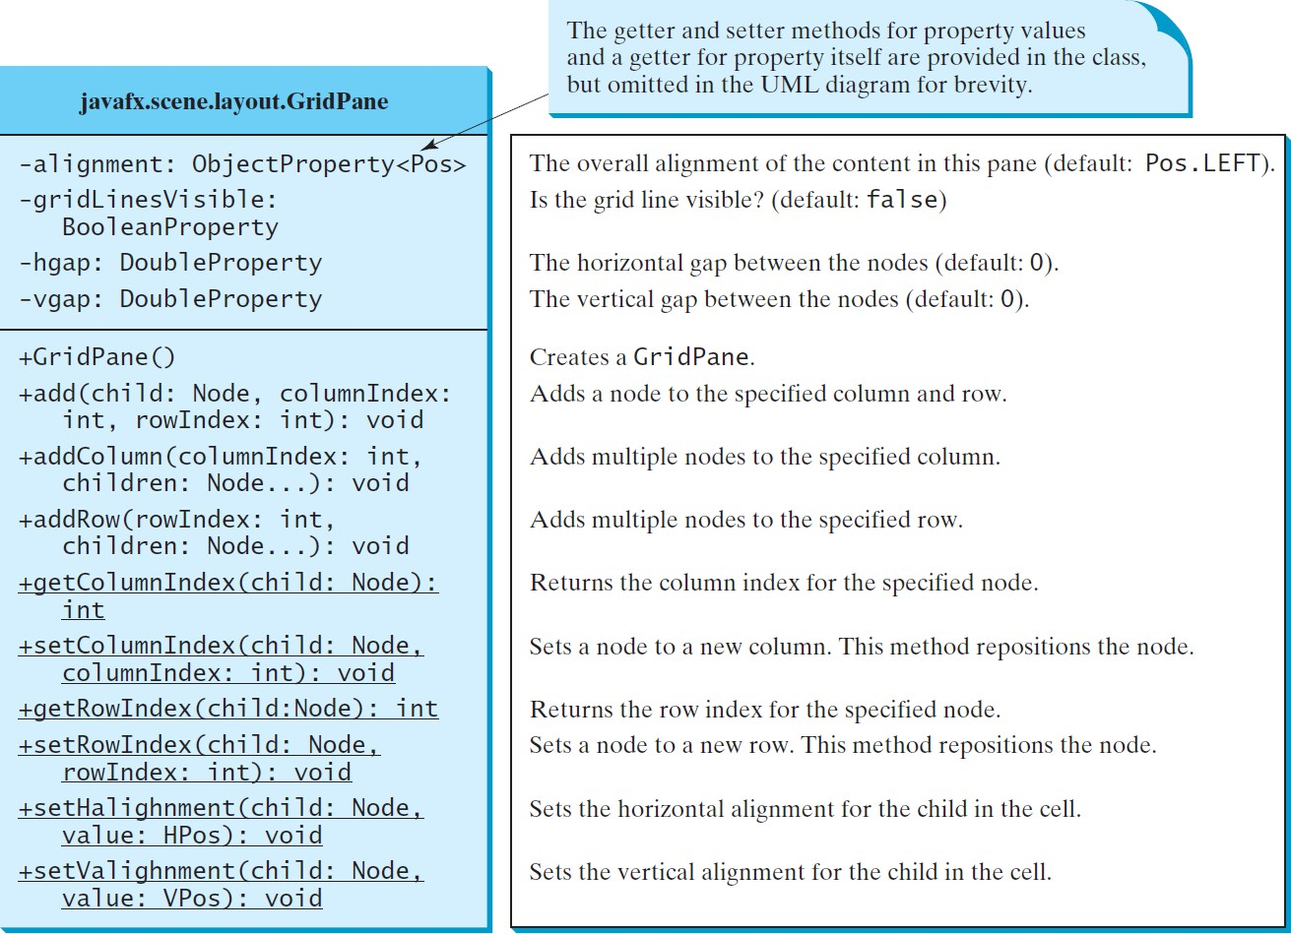
GridPane
ShowGridPane

Slide 45
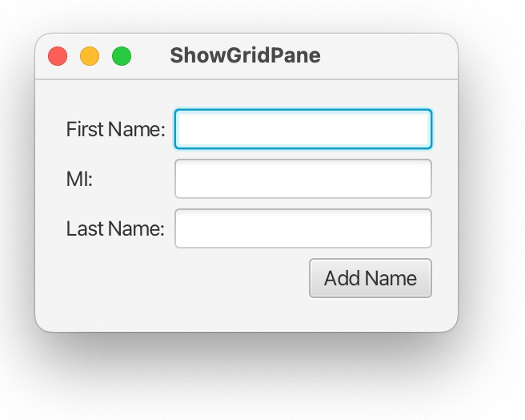
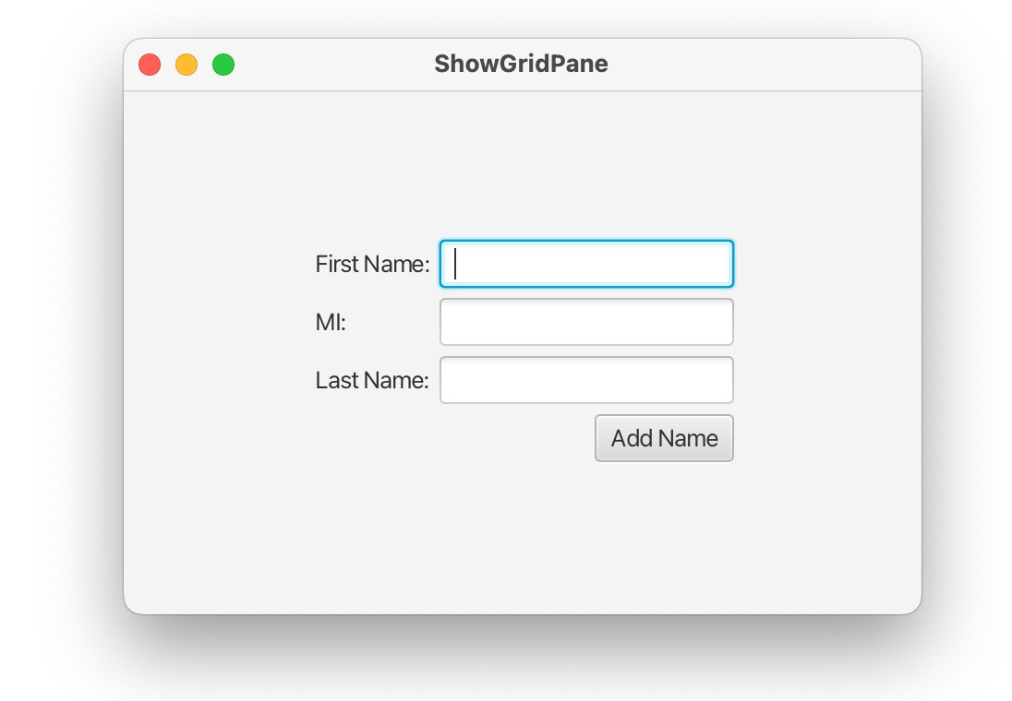
ShowGridPane

Slide 46
ShowGridPane
public void start(Stage primaryStage) {
// Create a pane and set its properties GridPane pane = new ;
pane.setAlignment(Pos. ); pane.setPadding(new Insets(11.5, 12.5, 13.5, 14.5)); pane.setHgap(5.5); pane.setVgap(5.5);
// Place nodes in the pane
pane.add(new Label("First Name:"), ); pane.add(new TextField(), ); pane.add(new Label("MI:"), ); pane.add(new TextField(), ); pane.add(new Label("Last Name:"), ); pane.add(new TextField(), );
Button btAdd = new Button("Add Name"); pane.add(btAdd, ); GridPane.setHalignment( , HPos.
);
// Create a scene and place it in the stage
}

Slide 47
ShowGridPane
public void start(Stage primaryStage) {
// Create a pane and set its properties
GridPane pane = new GridPane();
pane.setAlignment(Pos.CENTER);
pane.setPadding(new Insets(11.5, 12.5, 13.5, 14.5)); pane.setHgap(5.5); pane.setVgap(5.5);
// Place nodes in the pane
pane.add(new Label("First Name:"), 0, 0);
pane.add(new TextField(), 1, 0);
pane.add(new Label("MI:"), 0, 1);
pane.add(new TextField(), 1, 1);
pane.add(new Label("Last Name:"), 0, 2);
pane.add(new TextField(), 1, 2);
Button btAdd = new Button("Add Name");
pane.add(btAdd, 1, 3);
GridPane.setHalignment(btAdd, HPos.RIGHT);
// Create a scene and place it in the stage
}

Slide 48
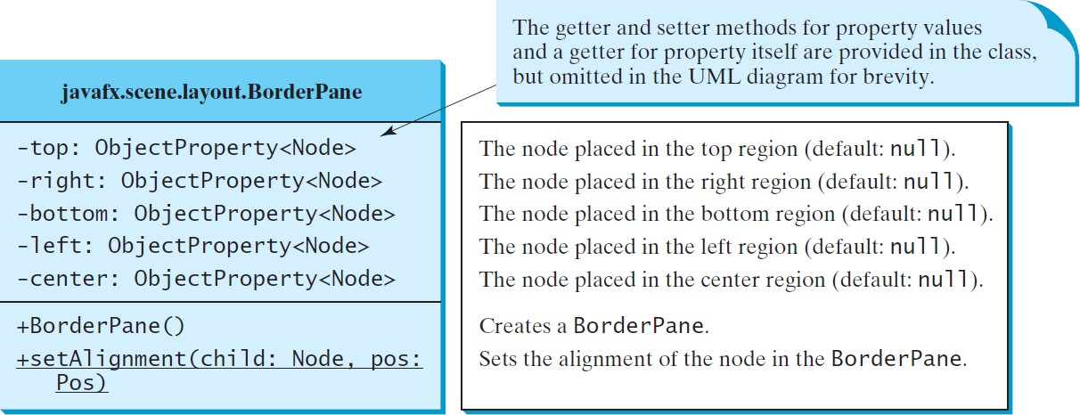
BorderPane
ShowBorderPane

Slide 49
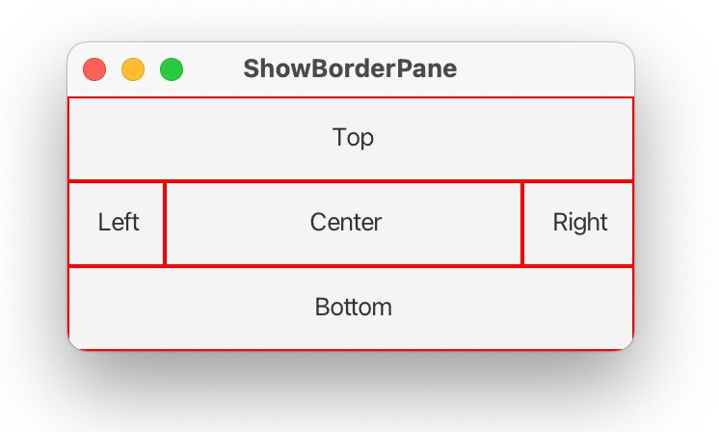
ShowBorderPane

Slide 50
ShowBorderPane
public void start(Stage primaryStage) {
// Create a border pane
BorderPane pane = new ;
// Place nodes in the pane
pane. pane. pane. pane. pane.
(new CustomPane("Top")); (new CustomPane("Right"));
(new CustomPane("Bottom")); (new CustomPane("Left"));
(new CustomPane("Center"));
// Create a scene and place it in the stage
}
}
// Define a custom pane to hold a label in the center of the pane class CustomPane extends StackPane {…
}

Slide 51
ShowBorderPane
public void start(Stage primaryStage) {
// Create a border pane
BorderPane pane = new BorderPane();
// Place nodes in the pane pane.setTop(new CustomPane("Top")); pane.setRight(new CustomPane("Right"));
pane.setBottom(new CustomPane("Bottom")); pane.setLeft(new CustomPane("Left")); pane.setCenter(new CustomPane("Center"));
// Create a scene and place it in the stage
}
}

Slide 52
ShowBorderPane
public void start(Stage primaryStage) {
// Create a border pane
// Create a scene and place it in the stage
}
}
// Define a custom pane to hold a label in the center of the pane class CustomPane extends StackPane {
public CustomPane(String title) { getChildren().add(new Label(title)); setStyle(" ");
setPadding(new Insets(11.5, 12.5, 13.5, 14.5));
}
}

Slide 53
ShowBorderPane
class CustomPane extends StackPane { public CustomPane(String title) {
getChildren().add(new Label(title)); setStyle("-fx-border-color: red");
setPadding(new Insets(11.5, 12.5, 13.5, 14.5));
}

Slide 54
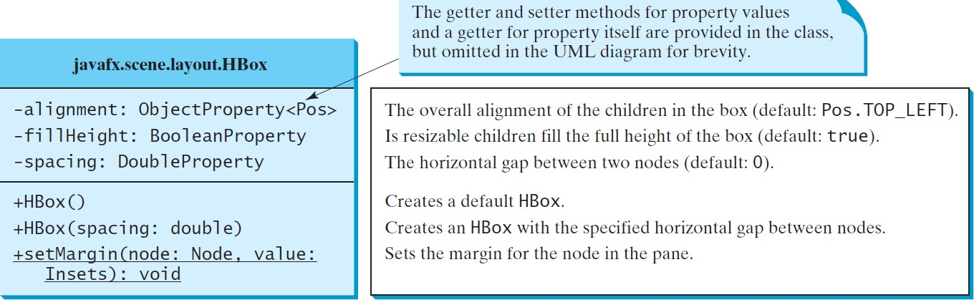
HBox

Slide 55
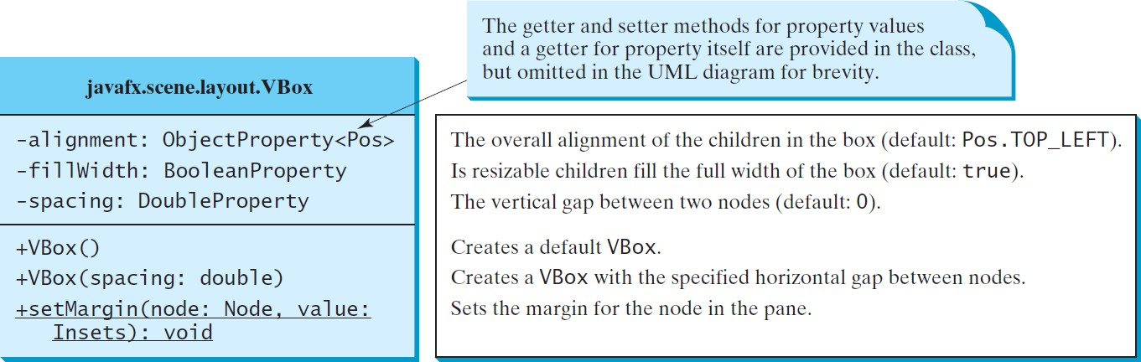
VBox
ShowHBoxVBox

Slide 56
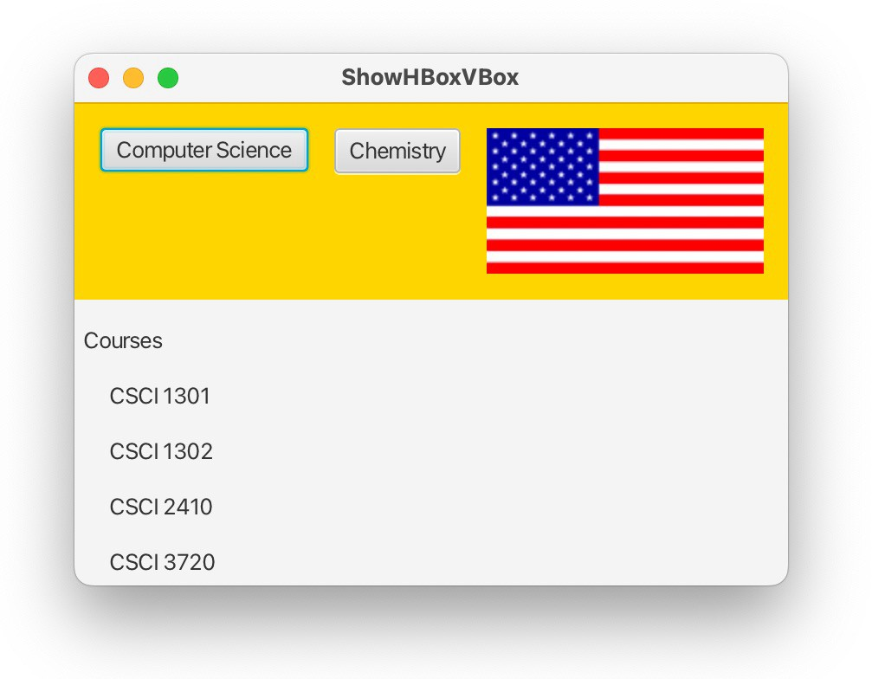
ShowHBoxVBox

Slide 57
ShowHBoxVBox
public void start(Stage primaryStage) {
// Create a border pane BorderPane pane = new
;
// Place nodes in the pane
pane.setTop( pane.setLeft(
);
);
// Create a scene and place it in the stage
}
private HBox getHBox() {
}
private VBox getVBox() {
}
57

Slide 58
ShowHBoxVBox
public void start(Stage primaryStage) {
// Create a border pane
BorderPane pane = new BorderPane();
// Place nodes in the pane pane.setTop(getHBox()); pane.setLeft(getVBox());
// Create a scene and place it in the stage Scene scene = new Scene(pane);
primaryStage.setTitle("ShowHBoxVBox"); // Set the stage title primaryStage.setScene(scene); // Place the scene in the stage
primaryStage.show(); // Display the stage
}

Slide 59
ShowHBoxVBox
private HBox getHBox() { HBox hBox = new (15);
hBox.setPadding(new Insets(15, 15, 15, 15)); hBox. ("-fx-background-color: gold");
hBox.getChildren().add(new hBox.getChildren().add(new
("Computer Science")); ("Chemistry"));
ImageView imageView = new ImageView(new Image("http://liveexample.pearsoncmg.com/book/image/us
.gif"));
hBox.getChildren().add( ); return hBox;
}

Slide 60
ShowHBoxVBox
private HBox getHBox() { HBox hBox = new HBox(15);
hBox.setPadding(new Insets(15, 15, 15, 15)); hBox.setStyle("-fx-background-color: gold"); hBox.getChildren().add(new Button("Computer Science")); hBox.getChildren().add(new Button("Chemistry")); ImageView imageView = new ImageView(new
Image("http://liveexample.pearsoncmg.com/book/image/us. gif"));
hBox.getChildren().add(imageView); return hBox;
}

Slide 61
ShowHBoxVBox
private VBox getVBox() { VBox vBox = new ;
vBox.setPadding(new Insets(15, 5, 5, 5)); vBox.getChildren().add(new Label("Courses"));
Label[] courses = {new ("CSCI 1301"), new ("CSCI 1302"), new Label("CSCI 2410"), new Label("CSCI 3720")};
for (Label course: courses) {
VBox. (course, new Insets(0, 0, 0, 15)); vBox.getChildren().add(course);
}
return vBox;
}

Slide 62
ShowHBoxVBox
private VBox getVBox() { VBox vBox = new VBox(15);
vBox.setPadding(new Insets(15, 5, 5, 5)); vBox.getChildren().add(new Label("Courses"));
Label[] courses = {new Label("CSCI 1301"), new Label("CSCI 1302"), new Label("CSCI 2410"), new Label("CSCI 3720")};
for (Label course: courses) { VBox.setMargin(course, new Insets(0, 0, 0, 15)); vBox.getChildren().add(course);
}
return vBox;
}

Slide 63
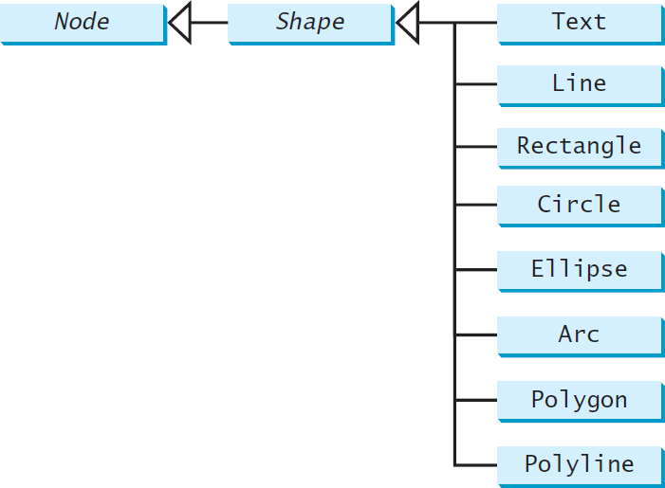
Shapes
JavaFX provides many shape classes for drawing texts, lines, circles, rectangles, ellipses, arcs, polygons, and polylines.

Slide 64
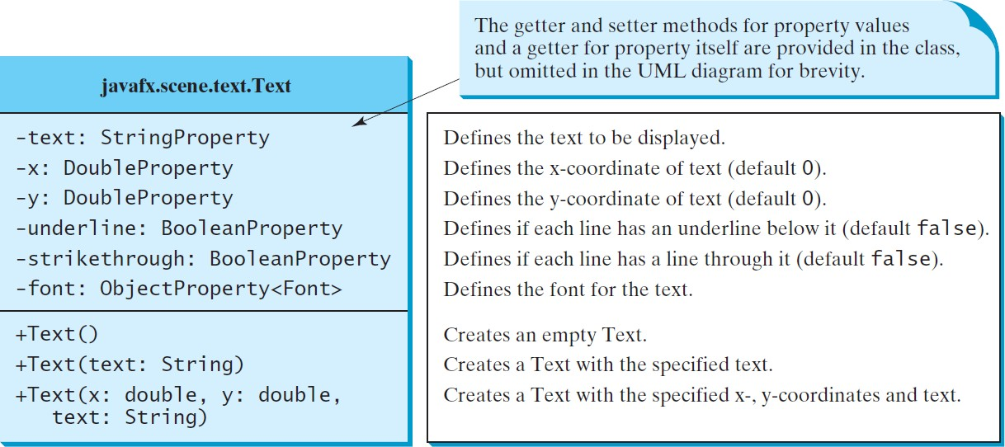
Text

Slide 65
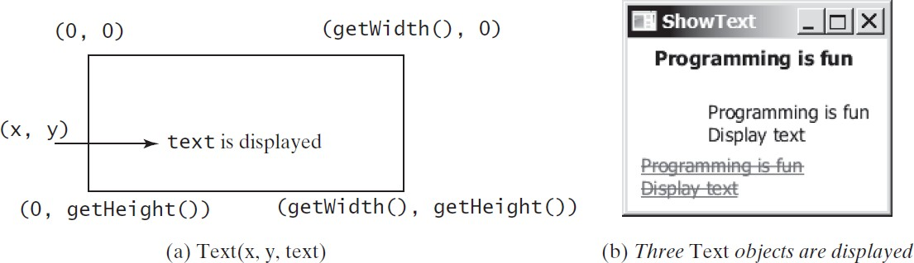
Text Example
ShowText

Slide 66
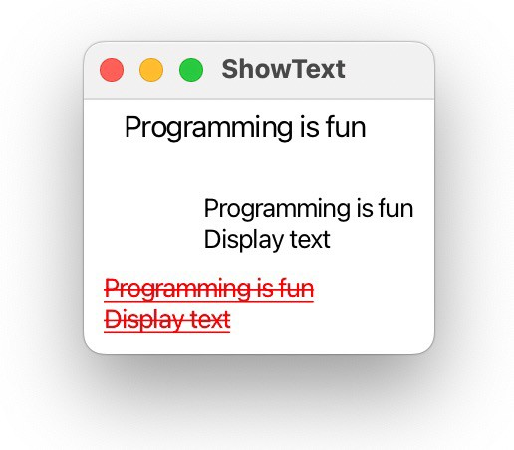
ShowText

Slide 67
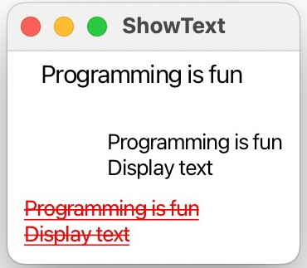
ShowText
public void start(Stage primaryStage) {
// Create a pane to hold the texts Pane pane = new Pane();
pane.setPadding(new Insets(5, 5, 5, 5));
Text text1 = new Text(20, 20, "Programming is fun"); text1.setFont(Font.font("Courier", FontWeight.
FontPosture. , 15)); pane.getChildren().add(text1);
,
Text text2 = new Text(60, 60, "Programming is fun\nDisplay text"); pane.getChildren().add(text2);
Text text3 = new Text(10, 100, "Programming is fun\nDisplay text");
text3.setFill(Color. text3.setUnderline( ); text3.setStrikethrough( );
);
pane.getChildren().add(text3);
// Create a scene and place it in the stage
}
67

Slide 68
ShowText
public void start(Stage primaryStage) {
// Create a pane to hold the texts Pane pane = new Pane();
pane.setPadding(new Insets(5, 5, 5, 5));
Text text1 = new Text(20, 20, "Programming is fun");
text1.setFont(Font.font("Courier", FontWeight.BOLD,
FontPosture.ITALIC, 15));
pane.getChildren().add(text1);
Text text2 = new Text(60, 60, "Programming is fun\nDisplay text"); pane.getChildren().add(text2);
Text text3 = new Text(10, 100, "Programming is fun\nDisplay text");
text3.setFill(Color.RED);
text3.setUnderline(true);
text3.setStrikethrough(true);
pane.getChildren().add(text3);
// Create a scene and place it in the stage
68

Slide 69
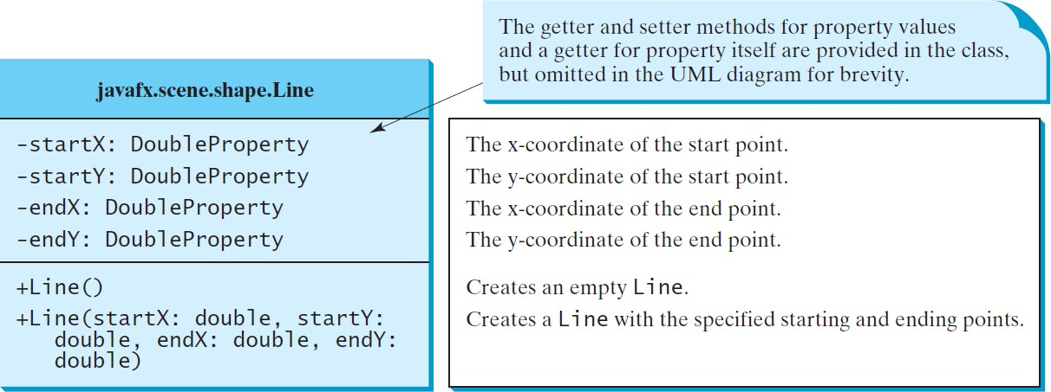
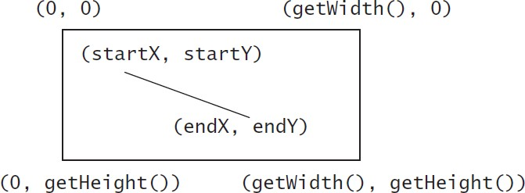
Line
ShowLine

Slide 70
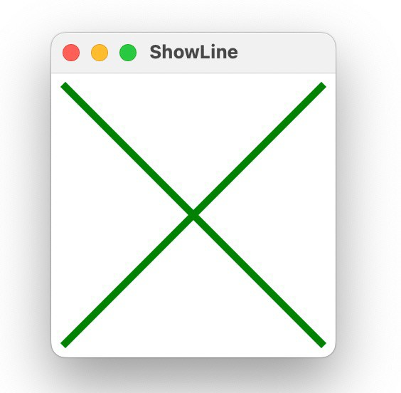
ShowLine

Slide 71
ShowLine
public class ShowLine extends Application {
@Override // Override the start method in the Application class public void start(Stage primaryStage) {
// Create a scene and place it in the stage
Scene scene = new Scene(new LinePane(), 200, 200); primaryStage.setTitle("ShowLine"); // Set the stage title
primaryStage.setScene(scene); // Place the scene in the stage primaryStage.show(); // Display the stage
}
}

Slide 72
ShowLine
class LinePane extends Pane { public LinePane() {
Line line1 = new Line(10, 10, 10, 10);
line1. line1.
.bind(
.bind(
);
);
line1.setStrokeWidth(5); line1.setStroke(
);
getChildren().add(line1);
Line line2 = new Line(10, 10, 10, 10);
line2. line2.
.bind(
.bind(
);
);
line2.setStrokeWidth(5); line2.setStroke(
);
getChildren().add(line2);
}
}

Slide 73
ShowLine
class LinePane extends Pane { public LinePane() {
Line line1 = new Line(10, 10, 10, 10); line1.endXProperty().bind(widthProperty().subtract(10)); line1.endYProperty().bind(heightProperty().subtract(10)); line1.setStrokeWidth(5);
line1.setStroke(Color.GREEN); getChildren().add(line1);
Line line2 = new Line(10, 10, 10, 10); line2.startXProperty().bind(widthProperty().subtract(10)); line2.endYProperty().bind(heightProperty().subtract(10)); line2.setStrokeWidth(5);
line2.setStroke(Color.GREEN); getChildren().add(line2);
}
}

Slide 74
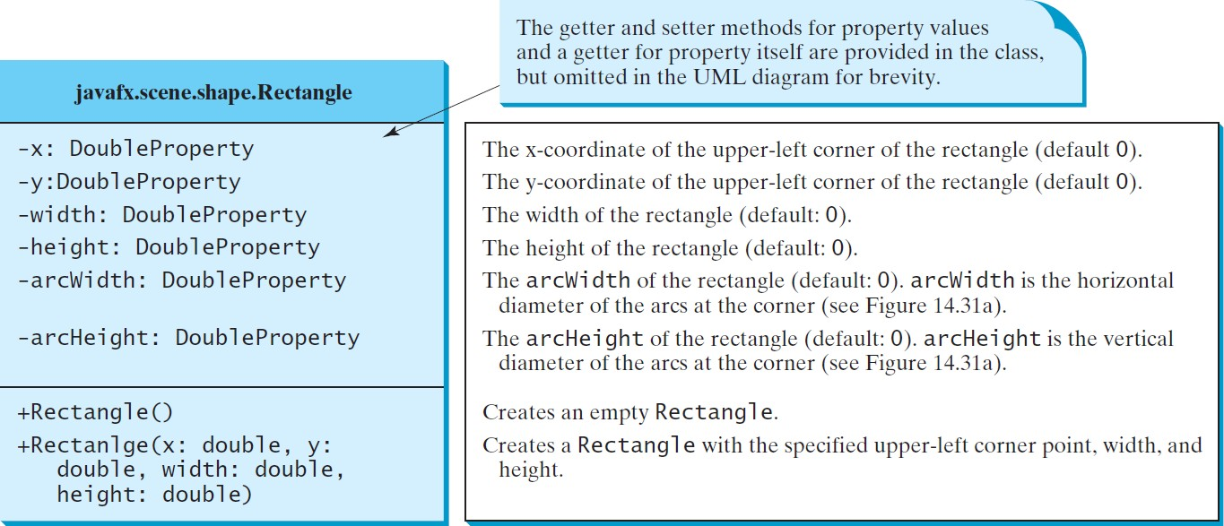
Rectangle

Slide 75
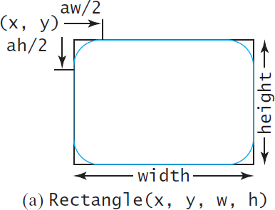
Rectangle Example
ShowRectangle

Slide 76
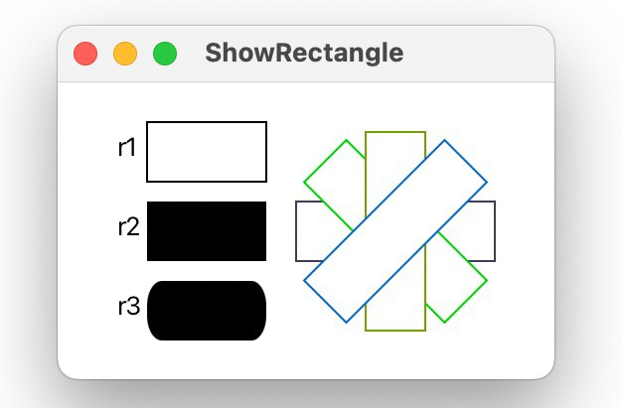
ShowRectangle

Slide 77
ShowRectangle
public void start(Stage primaryStage) {
// Create rectangles
Rectangle r1 = new Rectangle(25, 10, 60, 30); r1.setStroke( );
r1.setFill( );
Rectangle r2 = new Rectangle(25, 50, 60, 30);
Rectangle r3 = new Rectangle(25, 90, 60, 30);
r3.
r3.
(15);
(25);
// Create a group and add nodes to the group Group group = new Group();
group.getChildren(). (new Text(10, 27, "r1"), r1,
new Text(10, 67, "r2"), r2, new Text(10, 107, "r3"), r3);

Slide 78
ShowRectangle
public void start(Stage primaryStage) {
// Create rectangles
// Create a group and add nodes to the group for (int i = 0; i < 4; i++) {
Rectangle r = new Rectangle(100, 50, 100, 30);
r. (i * 360 / 8);
r.setStroke(Color.color(Math.random(), Math.random(), Math.random()));
r. (Color.WHITE); group.getChildren(). (r);
}

Slide 79
ShowRectangle
public void start(Stage primaryStage) {
// Create rectangles
Rectangle r1 = new Rectangle(25, 10, 60, 30); r1.setStroke(Color.BLACK); r1.setFill(Color.WHITE);
Rectangle r2 = new Rectangle(25, 50, 60, 30);
Rectangle r3 = new Rectangle(25, 90, 60, 30);
r3.setArcWidth(15); r3.setArcHeight(25);
// Create a group and add nodes to the group Group group = new Group();
group.getChildren().addAll(new Text(10, 27, "r1"), r1,
new Text(10, 67, "r2"), r2, new Text(10, 107, "r3"), r3);
for (int i = 0; i < 4; i++) {
Rectangle r = new Rectangle(100, 50, 100, 30);
r.setRotate(i * 360 / 8);
r.setStroke(Color.color(Math.random(), Math.random(), Math.random()));
r.setFill(Color.WHITE); group.getChildren().add(r);
}
79

Slide 80
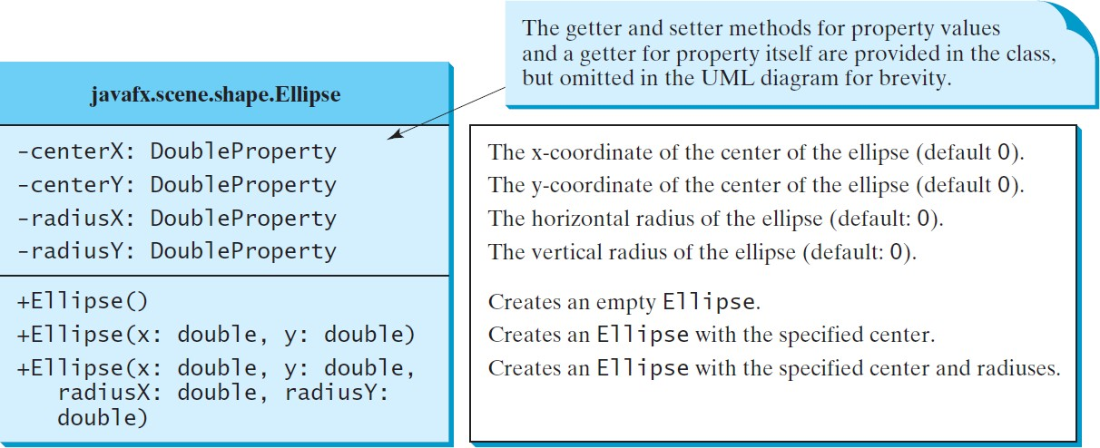
Ellipse
radiusX
radiusY
(centerX, centerY)
ShowEllipse

Slide 81
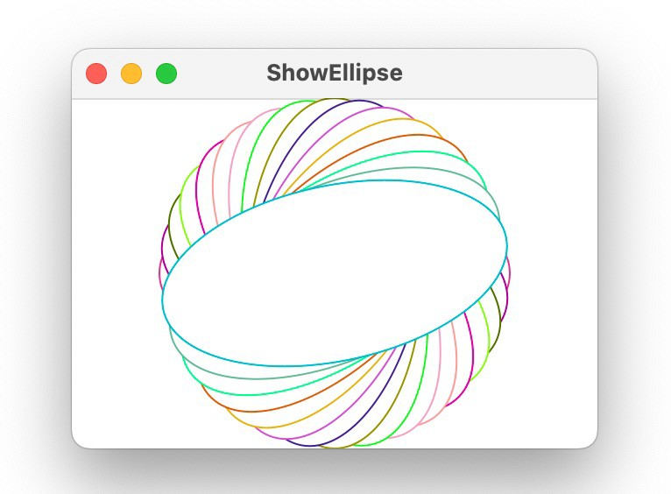
ShowEllipse

Slide 82
ShowEllipse
public class ShowEllipse extends Application {
@Override // Override the start method in the Application class public void start(Stage primaryStage) {
// Create a scene and place it in the stage
Scene scene = new Scene(new MyEllipse(), 300, 200); primaryStage.setTitle("ShowEllipse"); // Set the stage title primaryStage.setScene(scene); // Place the scene in the stage primaryStage.show(); // Display the stage
}
/**
The main method is only needed for the IDE with limited
JavaFX support. Not needed for running from the command line.
*/
public static void main(String[] args) {
launch(args);
}
}

Slide 83
ShowEllipse
class MyEllipse extends Pane { private void paint() {
getChildren().clear();
for (int i = 0; i < 16; i++) {
// Create an ellipse and add it to pane
Ellipse e1 = new Ellipse(getWidth() / 2, getHeight() / 2, getWidth() / 2 - 50, getHeight() / 2 - 50);
e1.setStroke(Color.color(Math.random(), Math.random(), Math.random()));
e1.setFill(Color.WHITE); e1.setRotate(i * 180 / 16); getChildren().add(e1);
}
}
}

Slide 84
ShowEllipse
class MyEllipse extends Pane { private void paint() {
….
}
@Override
public void setWidth(double width) { super.setWidth(width);
paint();
}
@Override
public void setHeight(double height) { super.setHeight(height);
paint();
}
}

Slide 85
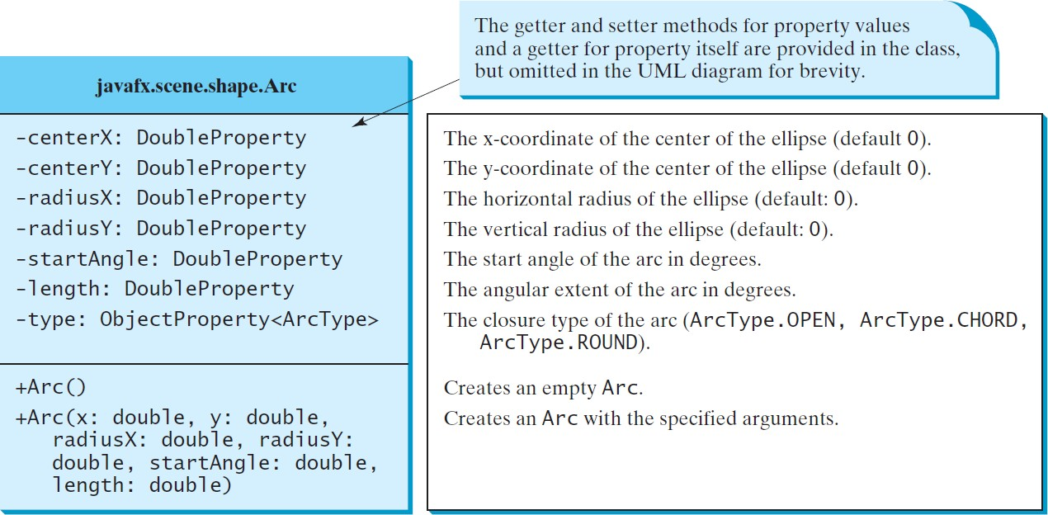
Arc

Slide 86
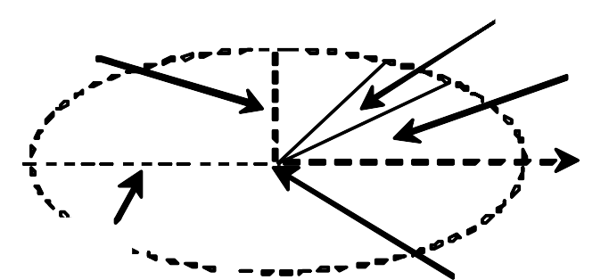
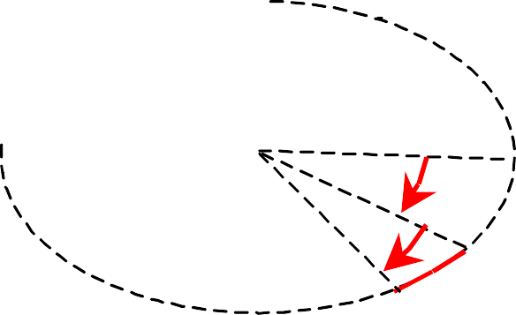
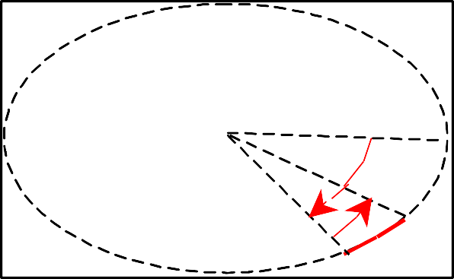
Arc Examples
radiusY
length
startAngle
0 degree
radiusX
(centerX, centerY)
–30°
–20°
–50°
20°
(a) Negative starting angle –30° and negative spanning angle –20°
(b) Negative starting angle –50° and positive spanning angle 20°
ShowArc

Slide 87
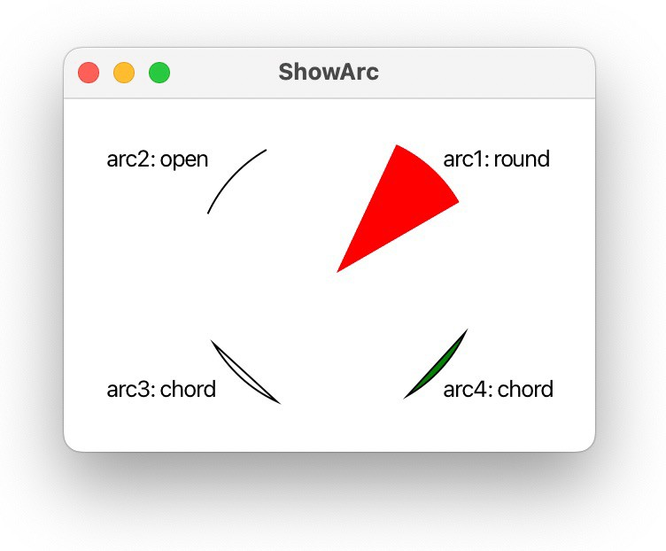
ShowArc

Slide 88
ShowArc
public void start(Stage primaryStage) {
Arc arc1 = new Arc(150, 100, 80, 80, 30, 35); // Create an arc arc1.setFill(Color.RED); // Set fill color
arc1.setType( ); // Set arc type
Arc arc2 = new Arc(150, 100, 80, 80, , 35);
arc2.setFill(Color.WHITE); arc2.setType( ); arc2.setStroke(Color.BLACK);
Arc arc3 = new Arc(150, 100, 80, 80, , 35);
arc3.setFill(Color.WHITE); arc3.setType( );
arc3.setStroke(Color.BLACK);
Arc arc4 = new Arc(150, 100, 80, 80, , 35);
arc4.setFill(Color.GREEN); arc4.setType( );
arc4.setStroke(Color.BLACK);

Slide 89
ShowArc
public void start(Stage primaryStage) {
Arc arc1 = new Arc(150, 100, 80, 80, 30, 35); // Create an arc arc1.setFill(Color.RED); // Set fill color arc1.setType(ArcType.ROUND); // Set arc type
Arc arc2 = new Arc(150, 100, 80, 80, 30 + 90, 35);
arc2.setFill(Color.WHITE); arc2.setType(ArcType.OPEN); arc2.setStroke(Color.BLACK);
Arc arc3 = new Arc(150, 100, 80, 80, 30 + 180, 35);
arc3.setFill(Color.WHITE); arc3.setType(ArcType.CHORD); arc3.setStroke(Color.BLACK);
Arc arc4 = new Arc(150, 100, 80, 80, 30 + 270, 35);
arc4.setFill(Color.GREEN); arc4.setType(ArcType.CHORD);
arc4.setStroke(Color.BLACK);

Slide 90
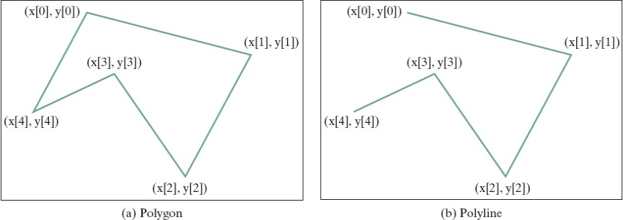
Polygon and Polyline

Slide 91
Polygon
The getter and setter methods for property values and a getter for property itself are provided in the class, but omitted in the UML diagram for brevity.
javafx.scene.shape.Polygon
+Polygon()
+Polygon(double... points)
+getPoints(): ObservableList<Double>
Creates an empty polygon.
Creates a polygon with the given points.
Returns a list of double values as x- and y-coordinates of the points.
ShowPolygon

Slide 92
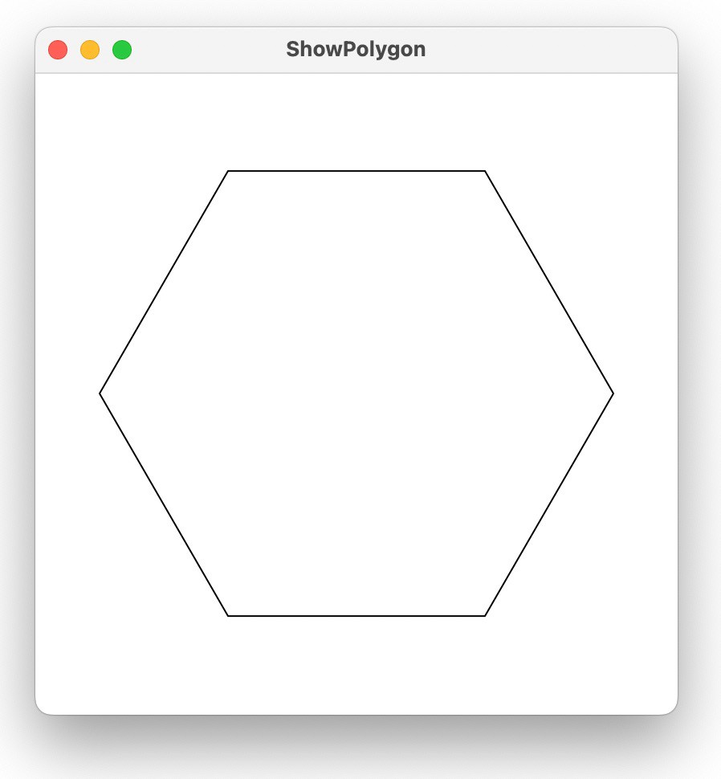
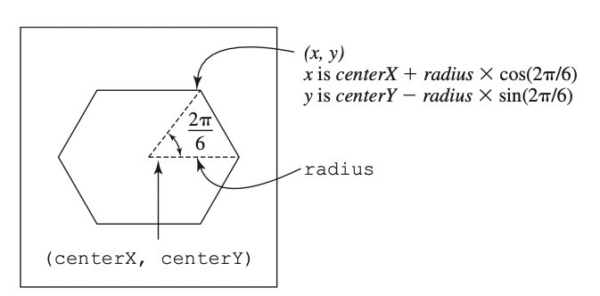
ShowPolygon

Slide 93
ShowPolygon
class MyPolygon extends Pane { private void paint() {
// Create a polygon and place polygon to pane Polygon polygon = new Polygon(); polygon.setFill(Color.WHITE); polygon.setStroke(Color.BLACK); ObservableList<Double> list = polygon.getPoints();
double centerX = getWidth() / 2, centerY = getHeight() / 2; double radius = Math.min(getWidth(), getHeight()) * 0.4;
// Add points to the polygon list for (int i = 0; i < 6; i++) {
}

Slide 94
ShowPolygon
class MyPolygon extends Pane { private void paint() {
}
getChildren().clear(); getChildren().add(polygon);
}
@Override
public void setWidth(double width) { super.setWidth(width);
paint();
}
@Override
public void setHeight(double height) { super.setHeight(height);
paint();
}
94

Slide 95
ShowPolygon
class MyPolygon extends Pane { private void paint() {
// Create a polygon and place polygon to pane Polygon polygon = new Polygon(); polygon.setFill(Color.WHITE); polygon.setStroke(Color.BLACK); ObservableList<Double> list = polygon.getPoints();
double centerX = getWidth() / 2, centerY = getHeight() / 2; double radius = Math.min(getWidth(), getHeight()) * 0.4;
// Add points to the polygon list for (int i = 0; i < 6; i++) {
list.add(centerX + radius * Math.cos(2 * i * Math.PI / 6)); list.add(centerY - radius * Math.sin(2 * i * Math.PI / 6));
}

Slide 96
Case Study: The ClockPane Class
This case study develops a class that displays a clock on a pane.
javafx.scene.layout.Panel
The getter and setter methods for these data fields are provided in the class, but omitted in the UML diagram for brevity.
ClockPane
-hour: int -minute: int -second: int
+ClockPane() +ClockPane(hour: int, minute: int, second: int) +setCurrentTime(): void +setWidth(width: double): void +setHeightTime(height: double): void
The hour in the clock. The minute in the clock. The second in the clock.
Constructs a default clock for the current time. Constructs a clock with the specified time.
Sets hour, minute, and second for current time. Sets clock pane’s width and repaint the clock, Sets clock pane’s height and repaint the clock,
ClockPane

Slide 97

Case Study: The ClockPane Class
DisplayClock

Slide 98

Case Study: The ClockPane Class

Slide 99
Case Study: The ClockPane Class
Circle circle = new Circle(centerX, centerY, clockRadius); circle.setFill(Color.WHITE); circle.setStroke(Color.BLACK);
Text t1 = new Text(centerX - 5, centerY - clockRadius + 12, "12"); Text t2 = new Text(centerX - clockRadius + 3, centerY + 5, "9"); Text t3 = new Text(centerX + clockRadius - 10, centerY + 3, "3"); Text t4 = new Text(centerX - 3, centerY + clockRadius - 3, "6");

Slide 100
Case Study: The ClockPane Class
// Draw second hand
double sLength = clockRadius * 0.8; double secondX = centerX + sLength *
Math.sin(second * (2 * Math.PI / 60)); double secondY = centerY - sLength *
Math.cos(second * (2 * Math.PI / 60));
Line sLine = new Line(centerX, centerY, secondX, secondY); sLine.setStroke(Color.RED);

Slide 101
Case Study: The ClockPane Class
// Draw minute hand
double mLength = clockRadius * 0.65; double xMinute = centerX + mLength *
Math.sin(minute * (2 * Math.PI / 60)); double minuteY = centerY - mLength *
Math.cos(minute * (2 * Math.PI / 60));
Line mLine = new Line(centerX, centerY, xMinute, minuteY); mLine.setStroke(Color.BLUE);
// Draw hour hand
double hLength = clockRadius * 0.5; double hourX = centerX + hLength *
Math.sin((hour % 12 + minute / 60.0) * (2 * Math.PI / 12)); double hourY = centerY - hLength *
Math.cos((hour % 12 + minute / 60.0) * (2 * Math.PI / 12)); Line hLine = new Line(centerX, centerY, hourX, hourY); hLine.setStroke(Color.GREEN);

Slide 102
Lecture 14: Event-Driven Programming and Animations

Slide 103

Motivations
Suppose you want to write a GUI program that lets the user enter a loan amount, annual interest rate, and number of years and click the Compute Payment button to obtain the monthly payment and total payment. How do you accomplish the task? You have to use event- driven programming to write the
code to respond to the button- clicking event.
LoanCalculator

Slide 104
Procedural vs. Event-Driven Programming
Procedural programming is executed in a procedural order.
In event-driven programming, code is executed upon activation of events.

Slide 105


Taste of Event-Driven Programming
The example displays a button in the frame.
A message is displayed on the console when a button is clicked.
The button is an event source object.
An object capable of handling the action event on a button. This object is called an event handler.
HandleEvent

Slide 106

Handling GUI Events
Source object (e.g., button)
Listener object contains a method for processing the event.

Slide 107
Handling GUI Events
Not all objects can be handlers for an action event. To be a handler of an action event, two requirements must be met:
The object must be an instance of the EventHandler<T extends Event> interface. This interface defines the
common behavior for all handlers. <T extends Event>
denotes that T is a generic type that is a subtype of
Event.
The EventHandler object handler must be registered with the event source object using the method source.setOnAction(handler).

Slide 108

Trace Execution
animation
public class HandleEvent extends Application {
public void start(Stage primaryStage) {
…
1. Start from the main method to
create a window and display it
OKHandlerClass handler1 = new OKHandlerClass(); btOK.setOnAction(handler1);
CancelHandlerClass handler2 = new CancelHandlerClass(); btCancel.setOnAction(handler2);
…
primaryStage.show(); // Display the stage
}
}
class OKHandlerClass implements EventHandler<ActionEvent> {
@Override
public void handle(ActionEvent e) { System.out.println("OK button clicked");
}
}

Slide 109
Trace Execution
animation
public class HandleEvent extends Application { public void start(Stage primaryStage) {
…
OKHandlerClass handler1 = new OKHandlerClass(); btOK.setOnAction(handler1);
CancelHandlerClass handler2 = new CancelHandlerClass(); btCancel.setOnAction(handler2);
…
primaryStage.show(); // Display the stage
}
}
2. Click OK
class OKHandlerClass implements EventHandler<ActionEvent> {
@Override
public void handle(ActionEvent e) { System.out.println("OK button clicked");
}
}

Slide 110

Trace Execution
animation
public class HandleEvent extends Application { public void start(Stage primaryStage) {
…
OKHandlerClass handler1 = new OKHandlerClass(); btOK.setOnAction(handler1);
3. The JVM invokes the listener’s handle
method
CancelHandlerClass handler2 = new CancelHandlerClass(); btCancel.setOnAction(handler2);
…
primaryStage.show(); // Display the stage
}
}
class OKHandlerClass implements EventHandler<ActionEvent> { @Override
public void handle(ActionEvent e) {
System.out.println("OK button clicked");
}
}
110

Slide 111
Events
An event can be defined as a type of signal to the program that something has happened.
The event is generated by external user actions such as mouse movements, mouse clicks, or keystrokes.
When you run a Java GUI program, the program interacts with the user and the events drive its execution. This is called event-driven programming.
110

Slide 112

Event Classes
110

Slide 113
Event Information
An event object contains whatever properties are pertinent to the event.
You can identify the source object of the event using the getSource() instance method in the EventObject class.
The subclasses of EventObject deal with special types of events, such as button actions, window events, mouse movements, and keystrokes.
110

Slide 114

Selected User Actions and Handlers
110

Slide 115

The Delegation Model
Java uses a delegation-based model for event handling: A source object fires an event, and an object interested in the event handles it. The latter object is called an event handler or an event listener.
110

Slide 116
The Delegation Model: Example
Button btOK = new Button("OK"); OKHandlerClass handler = new OKHandlerClass(); btOK.setOnAction(handler);
110

Slide 117

Example: First Version for ControlCircle (no listeners)
Now let us consider to write a program that uses two buttons to control the size of a circle.
ControlCircleWithoutEventHandling
110

Slide 118
public class ControlCircleWithoutEventHandling extends Application { @Override // Override the start method in the Application class public void start(Stage primaryStage) {
StackPane pane = new StackPane();
Circle circle = new Circle(50); circle.setStroke(Color.BLACK); circle.setFill(Color.WHITE); pane.getChildren().add(circle);
HBox hBox = new HBox();
hBox.setSpacing(10); hBox.setAlignment(Pos.CENTER); Button btEnlarge = new Button("Enlarge");
Button btShrink = new Button("Shrink"); hBox.getChildren().add(btEnlarge); hBox.getChildren().add(btShrink);
BorderPane borderPane = new BorderPane(); borderPane.setCenter(pane); borderPane.setBottom(hBox); BorderPane.setAlignment(hBox, Pos.CENTER);
// Create a scene and place it in the stage
Scene scene = new Scene(borderPane, 200, 150); primaryStage.setTitle("ControlCircle"); // Set the stage title primaryStage.setScene(scene); // Place the scene in the stage primaryStage.show(); // Display the stage
}
}
118

Slide 119


Example: Second Version for ControlCircle (with listener for Enlarge)
Now let us consider to write a program that uses two buttons to control the size of a circle.
ControlCircle

Slide 120
public class ControlCircle extends Application { private CirclePane circlePane = new CirclePane();
@Override // Override the start method in the Application class
public void start(Stage primaryStage) {
// Hold two buttons in an HBox
// Create and register the handler
// Create a scene and place it in the stage
}
class EnlargeHandler implements EventHandler<ActionEvent> {
}
}
public static void main(String[] args) {
launch(args);
}
}

Slide 121
class CirclePane extends StackPane { private Circle circle = new Circle(50);
public CirclePane() { getChildren().add(circle); circle.setStroke(Color.BLACK); circle.setFill(Color.WHITE);
}
public void enlarge() { circle.setRadius(circle.getRadius() + 2);
}
public void shrink() { circle.setRadius(circle.getRadius() > 2 ?
circle.getRadius() - 2 : circle.getRadius());
}
}

Slide 122
Inner Class Listeners
A listener class is designed specifically to create a listener object for a GUI component (e.g., a button).
It will not be shared by other applications.
So, it is appropriate to define the listener class inside the frame class as an inner class.

Slide 123
Inner Classes
Inner class: A class is a member of another class.
Advantages: In some applications, you can use an inner class to make programs simple.
An inner class can reference the data and methods defined in the outer class in which it nests, so you do not need to pass the reference of the outer class to the constructor of the inner class.

Slide 124

Inner Classes

Slide 125
Inner Classes
Inner classes can make programs simple and concise.
An inner class supports the work of its containing outer class and is compiled into a class named OuterClassName$InnerClassName.class.
For example, the inner class InnerClass in OuterClass is compiled into OuterClass$InnerClass.class.

Slide 126
Inner Classes
An inner class can be declared public, protected, or private subject to the same visibility rules applied to a member of the class.
An inner class can be declared static. A static inner class can be accessed using the outer class name.
A static inner class cannot access non-static members of the outer class

Slide 127
Anonymous Inner Classes
An anonymous inner class must always extend a superclass or implement an interface, but it cannot have an explicit extends or implements clause.
An anonymous inner class must implement all the abstract methods in the superclass or in the interface.
An anonymous inner class always uses the no-arg constructor
from its superclass to create an instance.
If an anonymous inner class implements an interface, the constructor is
Object().
An anonymous inner class is compiled into a class named OuterClassName$n.class.
For example, if the outer class Test has two anonymous inner classes, these two classes are compiled into Test$1.class and Test$2.class.

Slide 128
Anonymous Inner Classes
Inner class listeners can be shortened using anonymous inner classes.
An anonymous inner class is an inner class without a name.
It combines declaring an inner class and creating an instance of the class in one step.
new SuperClassName/InterfaceName() {
// Implement or override methods in superclass or interface
// Other methods if necessary
}

Slide 129


Anonymous Inner Classes
AnonymousHandlerDemo

Slide 130
AnonymousHandlerDemo
public class AnonymousHandlerDemo extends Application { @Override // Override the start method in the Application class public void start(Stage primaryStage) {
// Hold four buttons in an HBox HBox hBox = new HBox(); hBox.setSpacing(10); hBox.setAlignment(Pos.CENTER); Button btNew = new Button("New");
Button btOpen = new Button("Open"); Button btSave = new Button("Save"); Button btPrint = new Button("Print");
hBox.getChildren().addAll(btNew, btOpen, btSave, btPrint);
// Create and register the handler
}
}

Slide 131
Simplifying Event Handing Using Lambda Expressions
Lambda expression is a new feature in Java 8.
Lambda expressions can be viewed as an anonymous method with a concise syntax.
For example, the following code in (a) can be greatly simplified using a lambda expression in (b) in three lines.
btEnlarge.setOnAction(
new EventHandler<ActionEvent>() { @Override
public void handle(ActionEvent e) {
// Code for processing event e
}
}
});
btEnlarge.setOnAction(e -> {
// Code for processing event e
});
(a) Anonymous inner class event handler
(b) Lambda expression event handler

Slide 132
Basic Syntax for a Lambda Expression
The basic syntax for a lambda expression is either
(type1 param1, type2 param2, ...) -> expression
or
(type1 param1, type2 param2, ...) -> { statements; }
The data type for a parameter may be explicitly declared or implicitly inferred by the compiler.
The parentheses can be omitted if there is only one parameter without an explicit data type.

Slide 133
Single Abstract Method Interface (SAM)
The statements in the lambda expression is all for that method.
If it contains multiple methods, the compiler will not be able to compile the lambda expression.
So, for the compiler to understand lambda expressions, the interface must contain exactly one abstract method.
Such an interface is known as a functional interface, or a Single Abstract Method (SAM) interface.
LambdaHandlerDemo

Slide 134
LambdaHandlerDemo
public class AnonymousHandlerDemo extends Application { @Override // Override the start method in the Application class public void start(Stage primaryStage) {
// Hold two buttons in an HBox
// Create and register the handler
btNew.setOnAction(new EventHandler<ActionEvent>() { @Override // Override the handle method
public void handle(ActionEvent e) { System.out.println("Process New");}}); btOpen.setOnAction(new EventHandler<ActionEvent>() {
@Override // Override the handle method
public void handle(ActionEvent e) {System.out.println("Process Open");}}); btSave.setOnAction(new EventHandler<ActionEvent>() {
@Override // Override the handle method
public void handle(ActionEvent e) {System.out.println("Process Save");}}); btPrint.setOnAction(new EventHandler<ActionEvent>() {
@Override // Override the handle method
public void handle(ActionEvent e) {System.out.println("Process Print");}});
}
}

Slide 135
Problem: Loan Calculator
LoanCalculator

Slide 136

The MouseEvent Class
MouseEventDemo

Slide 137
MouseEventDemo
public class MouseEventDemo extends Application {
@Override // Override the start method in the Application class
public void start(Stage primaryStage) {
// Create a pane and set its properties
Pane pane = new Pane();
Text text = new Text(20, 20, "Programming is fun"); pane.getChildren().addAll(text); text.setOnMouseDragged(e -> {
});
// Create a scene and place it in the stage
}
}

Slide 138

The KeyEvent Class
KeyEventDemo

Slide 139

The KeyCode Constants

Slide 140
public class KeyEventDemo extends Application {
@Override // Override the start method in the Application class
public void start(Stage primaryStage) {
// Create a pane and set its properties
// Create a scene and place the pane in the stage
text.setOnKeyPressed(e -> { switch (e.getCode()) {
case DOWN: text.setY(text.getY() + 10); break;
case UP: text.setY(text.getY() - 10); break; case LEFT: text.setX(text.getX() - 10); break; case RIGHT: text.setX(text.getX() + 10); break; default:
if (e.getText().length() > 0) text.setText(e.getText());
}
});
text.requestFocus(); // text is focused to receive key input
}
144

Slide 141
Example: Control Circle with Mouse and Key
ControlCircleWithMouseAndKey

Slide 142
ControlCircleWithMouseAndKey
public class ControlCircleWithMouseAndKey extends Application { private CirclePane circlePane = new CirclePane();
@Override // Override the start method in the Application class
public void start(Stage primaryStage) {
// Hold two buttons in an HBox
// Create and register the handler
btEnlarge.setOnAction(e -> circlePane.enlarge()); btShrink.setOnAction(e -> circlePane.shrink());
// Create a scene and place it in the stage
circlePane.setOnMouseClicked(e -> {
if (e.getButton() == MouseButton.PRIMARY) { circlePane.enlarge();
}
else if (e.getButton() == MouseButton.SECONDARY) { circlePane.shrink();
}
});
}

Slide 143
Listeners for Observable Objects
You can add a listener to process a value change in an observable object.
An instance of Observable is known as an observable object, which contains the addListener(InvalidationListener listener) method for adding a listener. Once the value is changed in the property, a listener is notified.
The listener class should implement the InvalidationListener interface, which uses the invalidated(Observable o) method to handle the property value change.
Every binding property is an instance of Observable.
ObservablePropertyDemo
DisplayResizableClock

Slide 144

Animation
JavaFX provides the Animation class with the core functionality for all animations.

Slide 145

PathTransition
PathTransitionDemo
FlagRisingAnimation

Slide 146
PathTransitionDemo
public class PathTransitionDemo extends Application {
@Override // Override the start method in the Application class
public void start(Stage primaryStage) {
// Create a pane
// Create a rectangle
// Create a circle
// Add circle and rectangle to the pane
// Create a path transition PathTransition pt = new PathTransition(); pt.setDuration(Duration.millis( ); pt.setPath( );
pt.setNode( );
pt.setOrientation( PathTransition.OrientationType.ORTHOGONAL_TO_TANGENT); pt.setCycleCount(Timeline.INDEFINITE);
pt.setAutoReverse(true);
pt.play(); // Start animation
circle.setOnMousePressed(e -> pt.pause()); circle.setOnMouseReleased(e -> pt.play());

Slide 147
FlagRisingAnimation
public class FlagRisingAnimation extends Application {
@Override // Override the start method in the Application class
public void start(Stage primaryStage) {
// Create a pane
// Add an image view and add it to pane
// Create a path transition
PathTransition pt = new PathTransition(Duration.millis(10000),
new Line( pt.setCycleCount(5); pt.play(); // Start animation
), imageView);
153

Slide 148

FadeTransition
The FadeTransition class animates the change of the opacity in a node over a given time.
FadeTransitionDemo

Slide 149
FadeTransitionDemo
public class FadeTransitionDemo extends Application {
@Override // Override the start method in the Application class
public void start(Stage primaryStage) {
// Place an ellipse to the pane
// Apply a fade transition to ellipse
FadeTransition ft = new FadeTransition(Duration.millis(3000), ellipse); ft.setFromValue( );
ft.setToValue( );
ft.setCycleCount(Timeline.INDEFINITE); ft.setAutoReverse( );
ft.play(); // Start animation
// Control animation ellipse.setOnMousePressed(e -> ft.pause()); ellipse.setOnMouseReleased(e -> ft.play());

Slide 150
Timeline
PathTransition and FadeTransition define specialized animations.
The Timeline class can be used to program any animation using one or more KeyFrames.
Each KeyFrame is executed sequentially at a specified time interval.
Timeline inherits from Animation.

Slide 151

Clock Animation
ClockAnimation

Slide 152
Clock Animation
public class ClockAnimation extends Application {
@Override // Override the start method in the Application class
public void start(Stage primaryStage) {
// Create a clock
ClockPane clock = new ClockPane();
// Create a handler for animation
// Set a new clock time
};
// Create an animation for a running clock
// Start animation
// Create a scene and place it in the stage
// Set the stage title
// Place the scene in the stage
// Display the stage
}

Slide 153




Case Study: Bouncing Ball
BallPane
BounceBallControl

Slide 154
BallPane
public class BallPane extends Pane { public final double radius = 20; private double x = radius, y = radius; private double dx = 1, dy = 1;
private Circle circle = new Circle(x, y, radius);
private Timeline animation;
public BallPane() {
// Set ball color
// Place a ball into this pane
// Create an animation for moving the ball
}
public void play() { } public void pause() { }

Slide 155
public void increaseSpeed() { animation.setRate(animation.getRate() + 0.1); }
public void decreaseSpeed() {
animation.setRate( animation.getRate() > 0 ? animation.getRate() - 0.1 : 0); }
public DoubleProperty rateProperty() { return animation.rateProperty(); }
protected void moveBall() {
// Check boundaries
if (x < radius || x > getWidth() - radius) {
dx *= -1; // Change ball move direction
}
if (y < radius || y > getHeight() - radius) {
dy *= -1; // Change ball move direction
}
// Adjust ball position x += dx; y += dy; circle.setCenterX(x); circle.setCenterY(y);
}
162

Slide 156
BounceBallControl
public class BounceBallControl extends Application {
@Override // Override the start method in the Application class
public void start(Stage primaryStage) {
BallPane ballPane = new BallPane(); // Create a ball pane
// Pause and resume animation
// Increase and decrease animation
});
163

